Slide 1

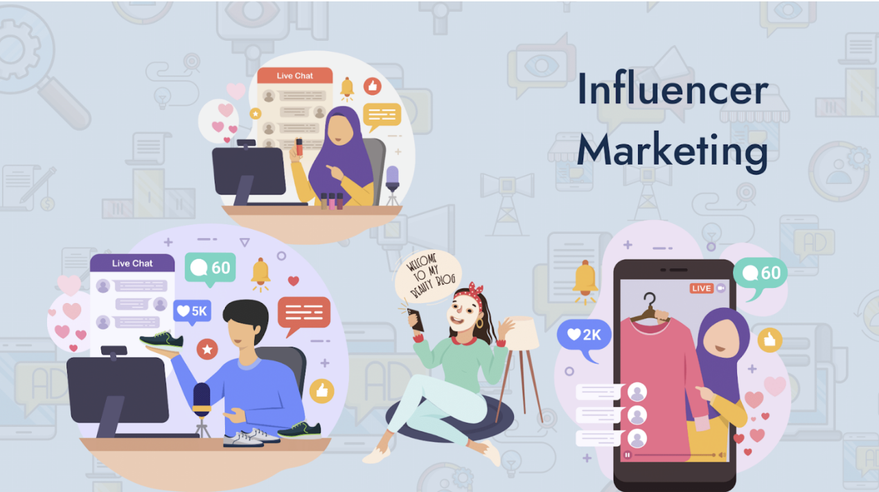
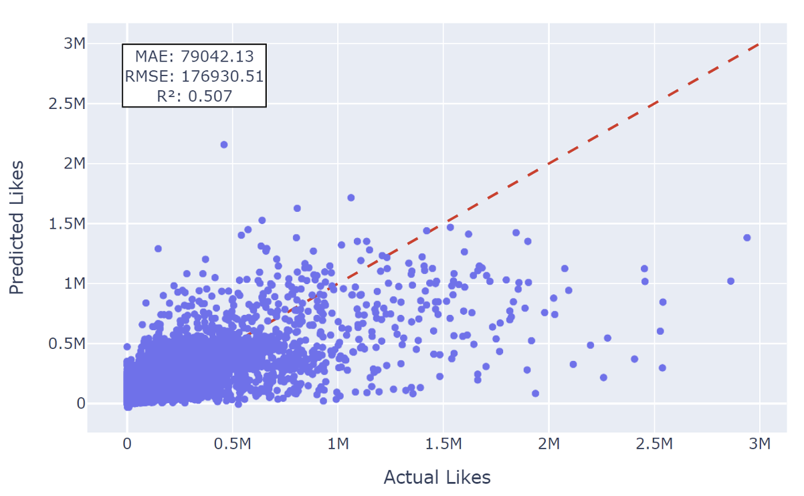
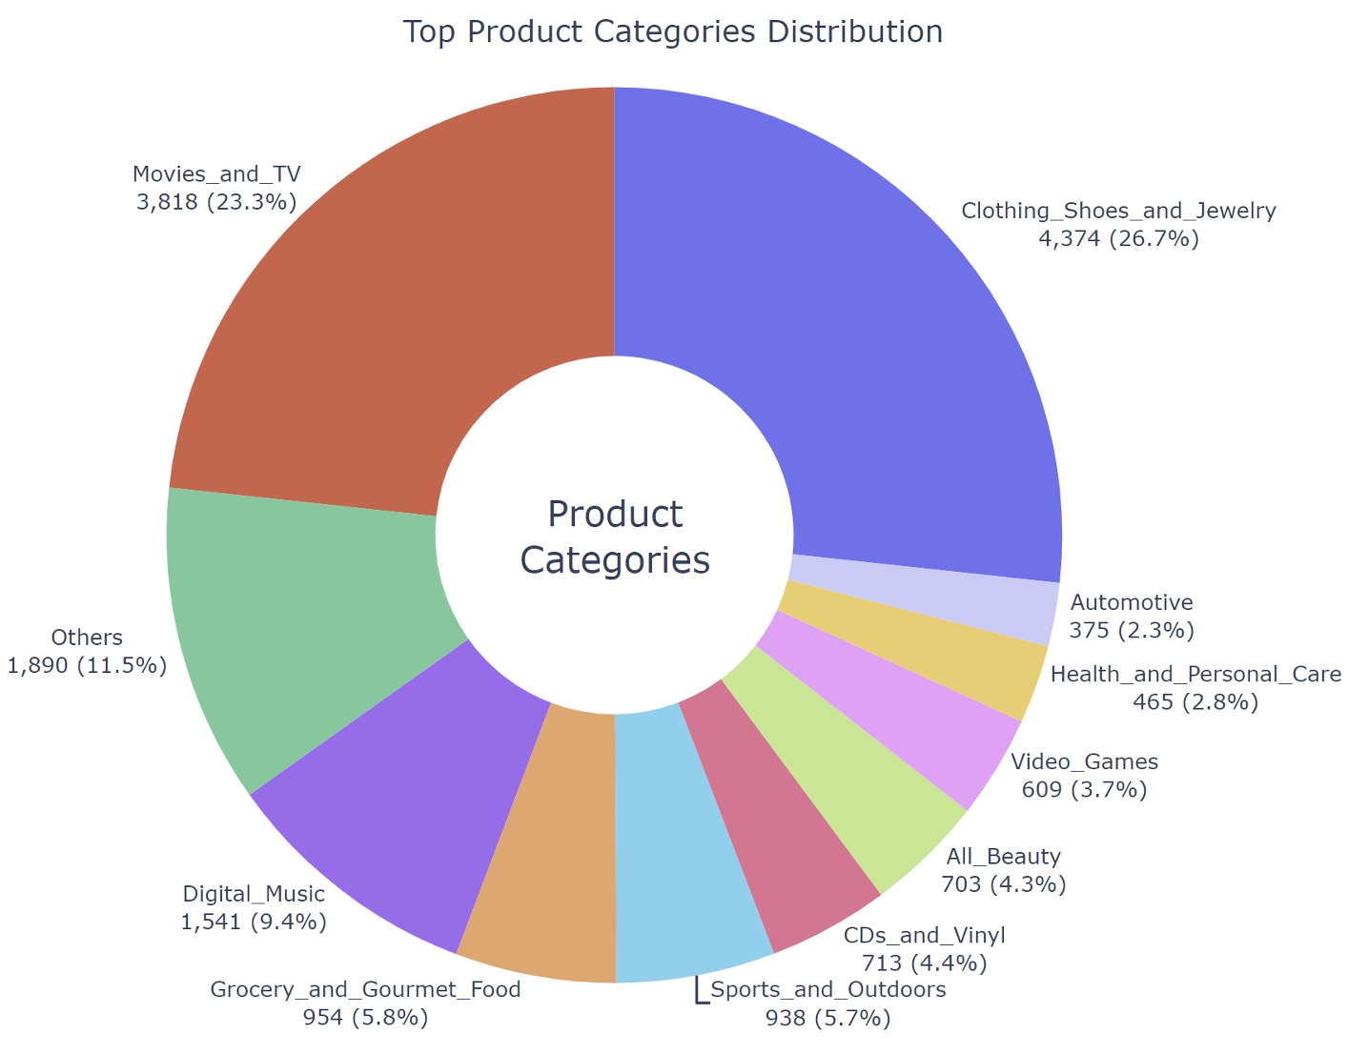
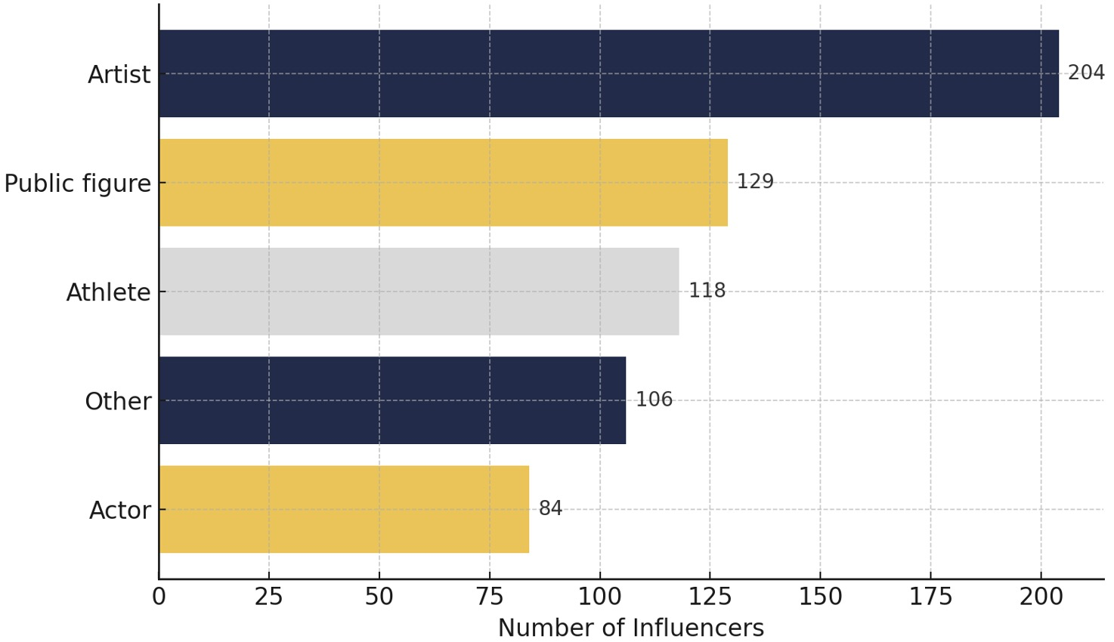
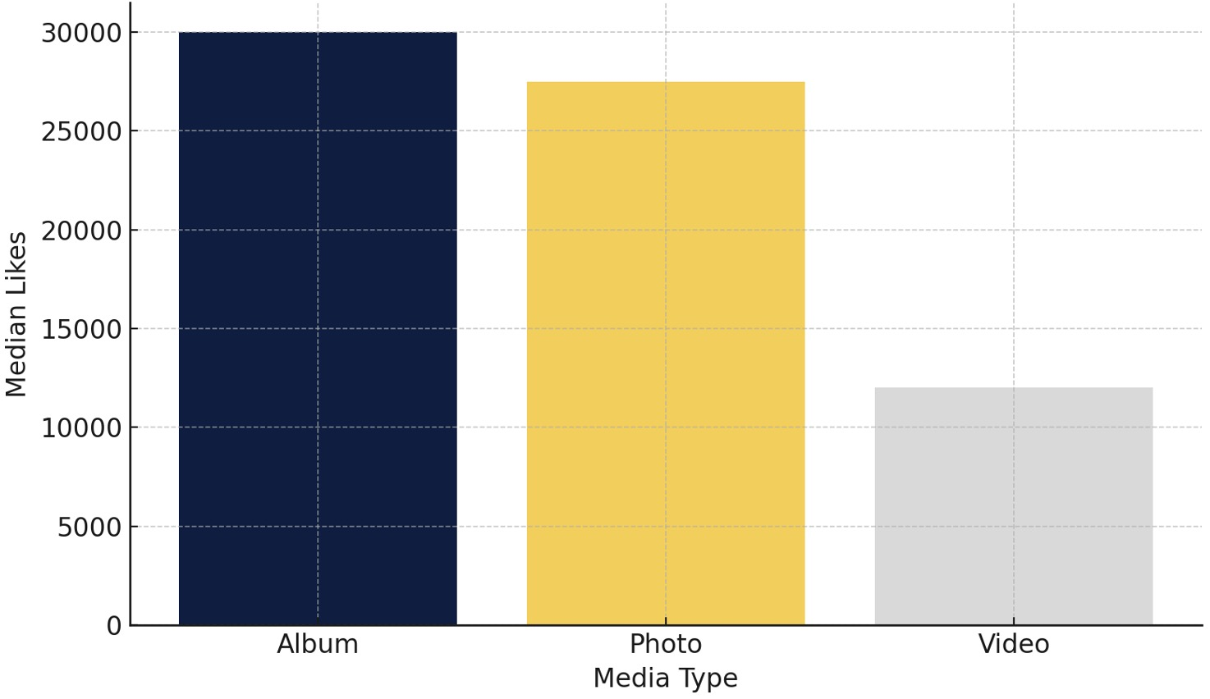
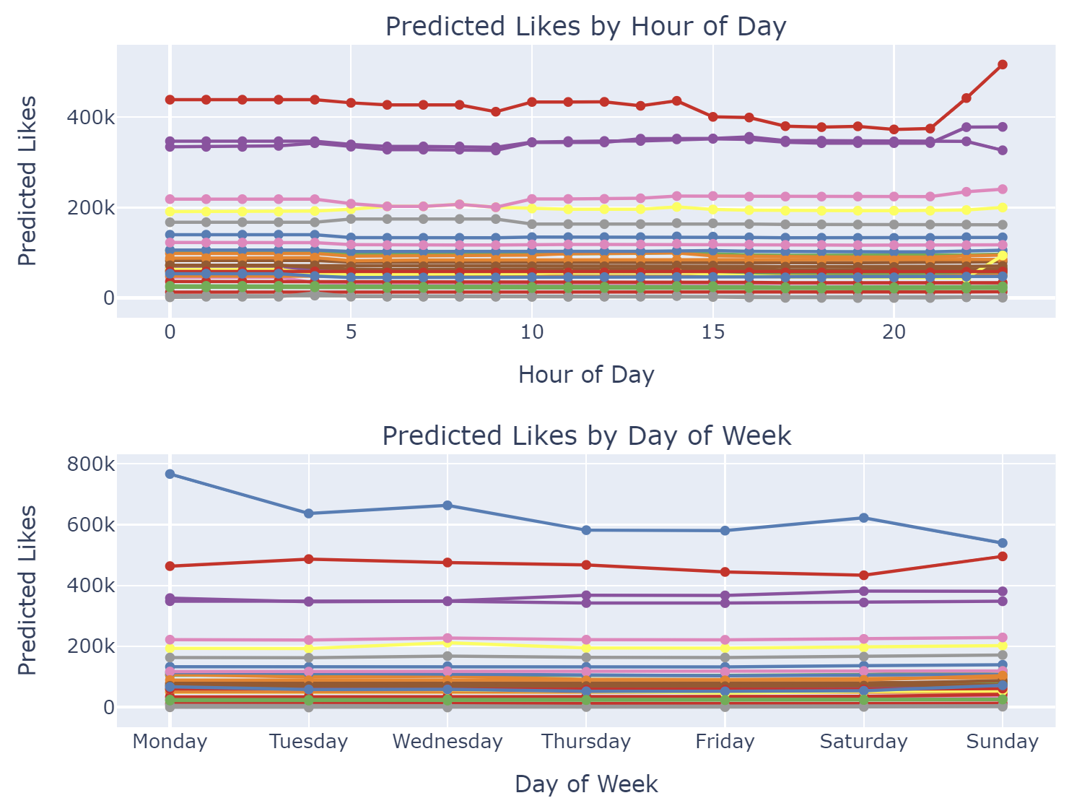
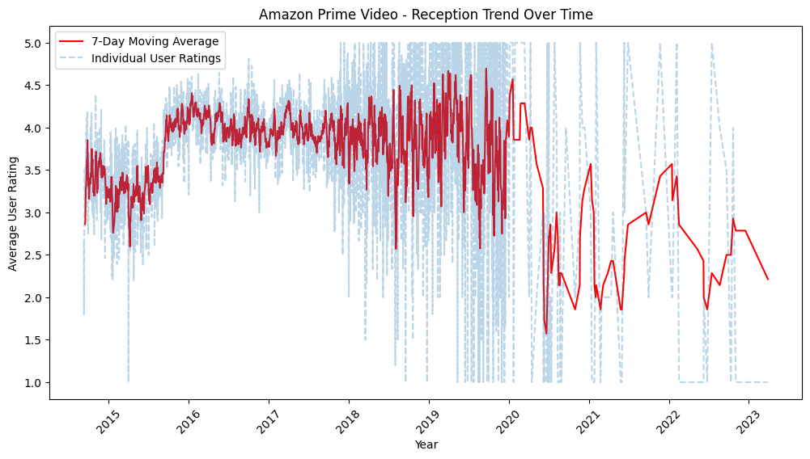
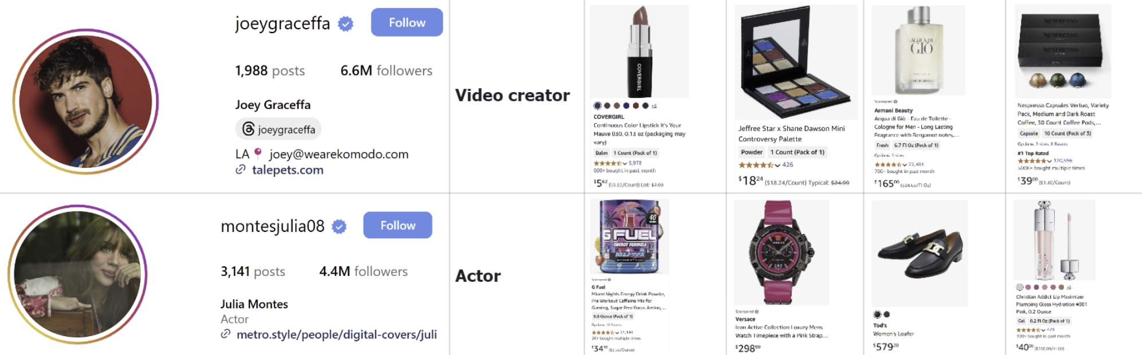

Online Influencer Product Recommendation System
Group 23
Members: Xinyao Chen, Anagha Niravane, Emily Qiu, Yulin Peng, Yijia Liu
Introduction
Data Analysis
Results
Conclusion
Background
Social media and e-commerce
integration have made influencers central to online sales. Choosing the right products to promote remains challenging, requiring a balance between market trends, personal brand, and audience preferences.
Goals
Develop a data-driven product recommendation system for social media influencers to enhance product promotion on E-Commerce platforms
The system aims:
1) Boost sales and commission earnings
2) Improve brand partnerships through more effective product placements
Influencer Profile Insights
Most selected influencers have 100k-1M followers. Categories like artists, public figures, and athletes are the most common [Figure A], while hospitality and nonprofit influencers have the highest followers.
Post Behavior & Engagement
Albums and photos are the most liked media types. Weekends (Afternoons/evenings) yield higher likes. Likes and comments are positively correlated.
Amazon product insights
Text reviews align with star ratings; however, many are neutral in tone. Review counts are heavily skewed, with most products having <10 review.
The system effectively matches products to influencers. LightGBM yielded the best engagement prediction (R^2 = 0.507) [Figure D], and the system favored fashion and entertainment products, while identifying untapped potential in health and personal care [Figure E]. Timing, post type, and historical engagement are key drivers of predicted performance.
Incorporated with Streamlit, our tool lets influencers input their profile and customize recommendation weights to receive top product picks. It shows predicted likes, category fit, and best posting time.
Figure D. Predicted vs. Actual Likes
Figure E. Product Category Distribution
Methods
Limitations
3-stage model
Input: Influencer ID/Name
Stage 1: Recall
Collaborative Filtering (TF-IIDF + Cosine Similarity + KNN)
History-based and Popularity-based Recall
Stage 2: Fine Ranking
Relevance Scoring = α × Predicted Likes + β × Similarity + γ × Product Fit
Engagement prediction (LightGBM)
Stage 3: Re-ranking
Embedding matching with Amazon Products (SBERT Embeddings for influencer caption and product vectorization; FAISS similarity search)
Output: Top-N Product Recommendations and Best Posting Time
Figure A. Top 5 Influencer Categories
Figure B. Median Likes by Media Type
Figure F. Engagement peaks in the late evening. Monday shows the highest predicted engagement, with Wednesday providing stable performance. High-engagement users are more sensitive to posting time. Fashion and beauty categories display high variability, whereas digital entertainment remains consistent.
Limited Product Information: Product names are shown without historical performance data
Heavy Dependence on Historical Data: the model performs best with influencers who have rich posting history. Less effective for cold-start influencers
No feedback loop or manual overrides: The system doesn’t support influencer or brand feedback to refine recommendations.
Figure C.
Sample Recommendation Output
Influencer Category Top 4 Recommended Products

